Slide 1
Computer Networks
The Network Layer
TCP/IP
Adrian Sergiu DARABANT
Lecture 8

Slide 2
IP Datagram
IP protocol version
number
32 bits
total datagram
length (bytes)
header length
(bytes)
head.
Len(4)
type of
Service(8)
Ver(4)
Length(16)
13 bit fragment
offset(13)
for
fragmentation/
reassembly
type of data
16-bit identifier(16)
Flgs(3)
max number
remaining hops
(decremented at
each router)
time to
Live(8)
upper
layer(8)
Header Internet
checksum(16)
DF+MF
32 bit source IP address(32)
upper layer protocol
to deliver payload to
32 bit destination IP address(32)
Options (if any)
E.g. timestamp,
record route
taken, specify
list of routers
to visit.
how much overhead with IP?
20 bytes of IP
+ transp layer overhead
data
(variable length,
typically a TCP
or UDP segment)

Slide 3
IP Checksum
The checksum field is the 16-bit one's complement of the one's complement sum of all 16-bit words in the header. For purposes of computing the checksum, the value of the checksum field is zero.
Hex 4500003044224000800600008c7c19acae241e2b (20 bytes IP header):
4500 + 0030 + 4422 + 4000 + 8006 + 0000 + 8c7c + 19ac + ae24 + 1e2b = 0002BBCF (32-bit sum)
0002 + BBCF = BBD1 = 1011101111010001 (1's complement 16-bit sum)
~BBD1 = 0100010000101110 = 442E (1's complement of 1's complement 16-bit sum)
Verify the Checksum at destination:
2BBCF + 442E = 2FFFD
2 + FFFD = FFFF (the 1's complement of FFFF) = 0.
Result is 0 means datagram header is OK !

Slide 4

Fragmentation/Reassembly
network links have MTU (max.transfer size) - largest possible link-level frame.
  different link types, different MTUs
large IP datagram divided (fragmented) within net
  one datagram becomes several datagrams
  reassembled only at final destination
  IP header bits used to identify, order related fragments
fragmentation:
in: one large datagram
out: 3 smaller datagrams
reassembly

Slide 5
Fragmentation/Reassembly
length
=4000
ID
=x
fragflag
=0
offset
=0
Example
4000 byte datagram
MTU = 1500 bytes
One large datagram becomes
several smaller datagrams
length
=1500
ID
=x
fragflag
=1
offset
=0
length
=1500
ID
=x
fragflag
=1
offset
=1480
length
=1060
ID
=x
fragflag
=0
offset
=2960

Slide 6
ARP: IP Addres vs Network Adapter Address
IP datagram: comm IP -> IP
misc
fields
source
IP addr
dest
IP addr
data
Ethernet: MAC -> MAC
How does one translates IP to MAC addresses ?
Where can I see my MAC addresses ?
Who manages these mapping ?
ARP – Address Resolution Protocol
Ifconfig or ipconfig – shows also the MAC address
TCP/IP stack – using ARP tables – see arp command

Slide 7
NAT – Network Address Translation
rest of
Internet
local network
(e.g., home network)
10.0.0/24
10.0.0.1
10.0.0.4
10.0.0.2
138.76.29.7
10.0.0.3
All datagrams leaving local
network have same single source NAT IP address: 138.76.29.7,
different source port numbers
Datagrams with source or
destination in this network
have 10.0.0/24 address for
source, destination (as usual)

Slide 8
NAT – Network Address Translation
Motivation: local network uses just one IP address as far as outside word is concerned:
  no need to be allocated range of addresses from ISP: - just one IP address is used for all devices
  can change addresses of devices in local network without notifying outside world
  can change ISP without changing addresses of devices in local network
  devices inside local net not explicitly addressable, visible by outside world (a security plus).

Slide 9
NAT – Network Address Translation
NAT translation table
WAN side addr LAN side addr
1: host 10.0.0.1
sends datagram to
128.119.40.186, 80
138.76.29.7, 5001 10.0.0.1, 3345
…… ……
S: 10.0.0.1, 3345
D: 128.119.40.186, 80
10.0.0.1
1
2
S: 138.76.29.7, 5001
D: 128.119.40.186, 80
10.0.0.4
10.0.0.2
138.76.29.7
S: 128.119.40.186, 80
D: 10.0.0.1, 3345
4
S: 128.119.40.186, 80
D: 138.76.29.7, 5001
3
10.0.0.3
4: NAT router
changes datagram
dest addr from
138.76.29.7, 5001 to 10.0.0.1, 3345
3: Reply arrives
dest. address:
138.76.29.7, 5001

Slide 10
NAT – Network Address Translation
16-bit port-number field:
  Roughly 60,000 simultaneous connections with a single LAN-side address!
NAT is controversial:
  routers should only process up to layer 3
  violates end-to-end argument
    NAT possibility must be taken into account by app designers, e.g., P2P applications
  address shortage should instead be solved by IPv6

Slide 11
ICMP
Used by hosts, routers, gateways to communication network-level information
  error reporting: unreachable host, network, port, protocol
  echo request/reply (used by ping)
Network-layer above IP:
  ICMP msgs carried in IP datagrams
ICMP message: type, code plus first 8 bytes of IP datagram causing error

Slide 12
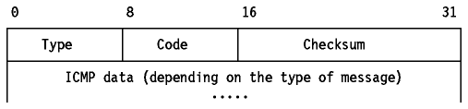
ICMP
Type Code description
0 0 echo reply (ping)
3 0 dest. network unreachable
3 1 dest host unreachable
3 2 dest protocol unreachable
3 3 dest port unreachable
3 6 dest network unknown
3 7 dest host unknown
Type Code description
4 0 source quench (congestion
control - not used)
8 0 echo request (ping)
9 0 route advertisement
10 0 router discovery
11 0 TTL expired
12 0 bad IP header

Slide 13
Network diagnostic - Debuging
Tcpdump – Wireshark – your network debuger
Ping – uses ICMP Echo and Reply to determine if a host is up
Traceroute – determine the path (as routers) from a source host to a destination host using UDP(usually).

Slide 14
Traceroute
Uses IP TTL to trace packet paths
S1: Set TTL=1 send a UDP datagram to destination => discarded on first Router and ICMP sent back with the Router IP as source (display it)
S2: TTL=2 send a UDP datagram to destination => discarded on 2nd Router and ICMP sent back with the Router IP as source (display it)
S3: TTL=3 repeat ….
S1…Sn – UDP port used is a rarely used port. When destination is reached => send back ICMP port unreachable – Clever !

Slide 15
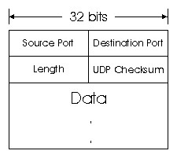
UDP
how much overhead with UDP?
20 bytes of IP
8 bytes of UDP
= 28 bytes + app layer overhead
Checksum – for the entire datagram (header + data)
Length >=8 – entire datagram

Slide 16
UDP Rules
Unreliable – When a message is sent, it cannot be known if it will reach its destination; it could get lost along the way. There is no concept of acknowledgment, retransmission, or timeout.
Not ordered – If two messages are sent to the same recipient, the order in which they arrive cannot be predicted.
Lightweight – There is no ordering of messages, no tracking connections, etc. It is a small transport layer designed on top of IP.
Datagrams – Packets are sent individually and are checked for integrity only if they arrive. Packets have definite boundaries which are honored upon receipt, meaning a read operation at the receiver socket will yield an entire message as it was originally sent.
No congestion control – UDP itself does not avoid congestion, and it's possible for high bandwidth applications to trigger congestion collapse, unless they implement congestion control measures at the application level.

Slide 17
TCP - Data Transfer
Ordered data transfer — the destination host rearranges data according to the Sequence number
Retransmission of lost packets — any cumulative stream not acknowledged is retransmitted
Error-free data transfer –consequence of the above
Flow control (Window based)— limits the rate a sender transfers data to guarantee reliable delivery. The receiver continually hints the sender on how much data can be received (controlled by the sliding window). When the receiving host's buffer fills, the next acknowledgment contains a 0 in the window size, to stop transfer and allow the data in the buffer to be processed.
Congestion control

Slide 18
TCP vs UDP –fun way ☺
TCP:
Hi, I'd like to hear a TCP joke.
Hello, would you like to hear a TCP joke?
Yes, I'd like to hear a TCP joke.
OK, I'll tell you a TCP joke.
Ok, I will hear a TCP joke.
Are you ready to hear a TCP joke?
Yes, I am ready to hear a TCP joke.
Ok, I am about to send the TCP joke. It will last 10 seconds, it has two characters, it does not have a setting, it ends with a punchline.
Ok, I am ready to get your TCP joke that will last 10 seconds, has two characters, does not have an explicit setting, and ends with a punchline.
I'm sorry, your connection has timed out.
Hello, would you like to hear a TCP joke?
UDP:
Want to hear an UDP joke?
Yes.
Was it good?
What?

Slide 19
TCP implementation- what we need ?
Data Loss ? => each sent packet needs confirmation. Re-transmission !
Out of order ? => data buffering on reception
Data Flow ?=> infer network and peer status
Network Congestion ?=> infer network status
All of the above ? =>keep status on each side and initialize it at begining

Slide 20
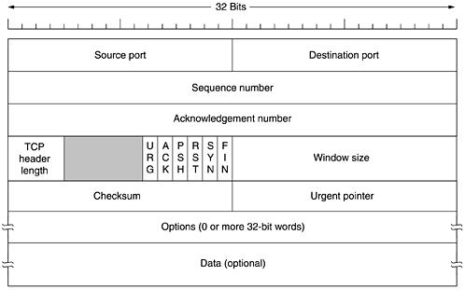
TCP Segment
how much overhead with TCP?
20 bytes of TCP
20 bytes of IP
= 40 bytes + app layer overhead

Slide 21
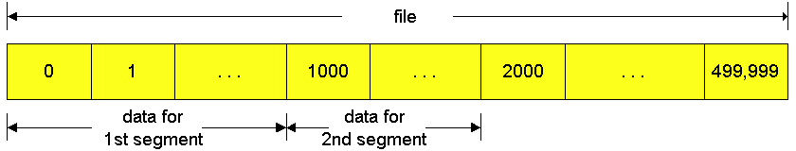
TCP Segments
Data is a contiguous stream split into segments
Each segment is carried into one (or multiple) IP datagrams
Each segment needs an acknowledgement from receiver
Send/Receive operations act on the stream they are not paired to each-other (i.e. one read for multiple sends)

Slide 22
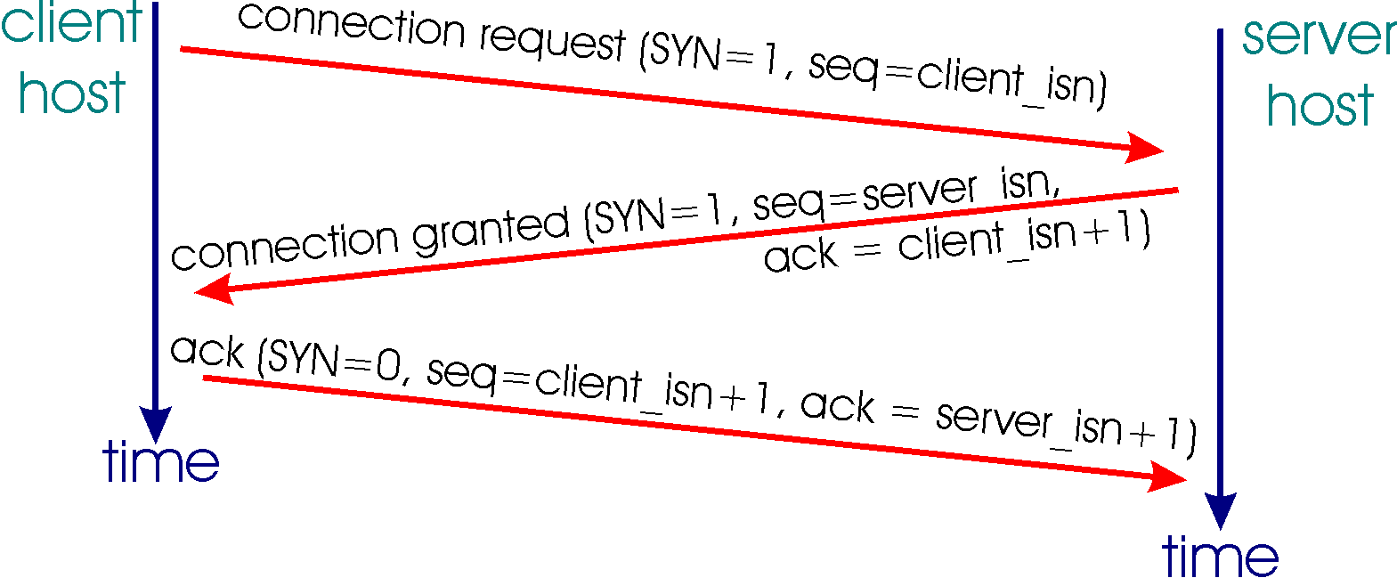
TCP Open – 3-way handshake

Slide 23
TCP Connection Teardown
Closing a connection:
client closes socket: clientSocket.close();
Step 1: client end system sends TCP FIN control segment to server
Step 2: server receives FIN, replies with ACK. Closes connection, sends FIN.
client
server
close
FIN
ACK
close
FIN
ACK
timed wait
closed

Slide 24
Seq numbers and Acks
Sequence numbers are used to reassemble data in the order in which it was sent.
Sequence numbers increment based on the number of bytes in the TCP data field.
  –Known as a Byte Sequencing Protocol
Each segment transmitted must be acknowledged.
  –Multiple segments can be acknowledged
The ACK (Acknowledgement) field indicates the next byte (sequence) number the receiver expects to receive.
The sender, no matter how many transmitted segments, expects to receive an ACK that is one more than the number of the last transmitted byte.

Slide 25


TCP States
TCP client
TCP Server

Slide 26
TCP Flow & Window Control
Sliding Window mechanism -> the number of allowed unacknowledged bytes
  Stop and Wait
  Go-back N (TCP)
  Selective Repeat
Receiver Window
Sender Window

Slide 27
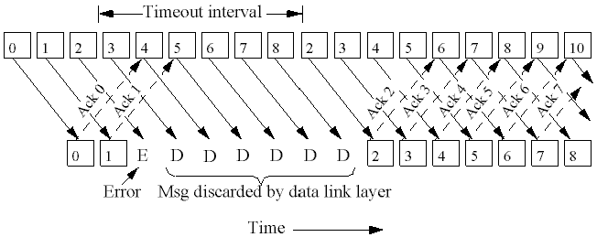
Go Back N
If seg k not received => discard k+1, k+2, etc
This implicitly sets the Window Size =1

Slide 28
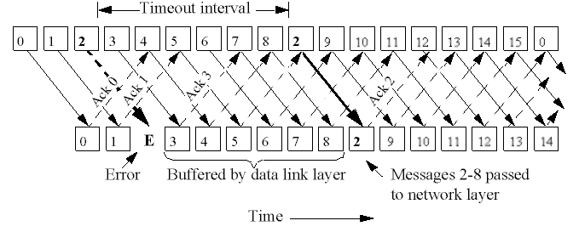
Selective Repeat

Slide 29
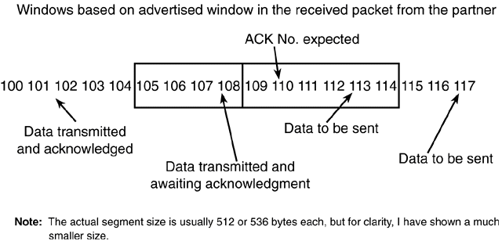
TCP (Send) Sliding Window

Slide 30
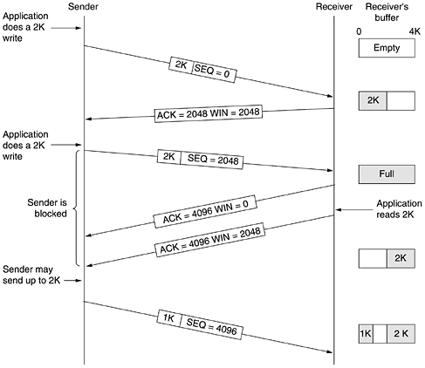
Receiver Window Management

Slide 31
TCP Retransmission
TCP will retransmit a segment upon expiration of an adaptive transmission timer.
The timer is variable.
When TCP transmits a segment, it records the time of transmission and the sequence number of the segment.
When TCP receives an acknowledgment, it records the time.
This allows TCP to build a sample round-trip delay time. (RTT)
TCP will build an average delay time for a packet to be sent and received.
The timer is slowly changed to allow for the varying differences in the Internet.

Slide 32

TCP round trip time, timeout
EstimatedRTT = (1- α)*EstimatedRTT + α*SampleRTT
exponential weighted moving average
influence of past sample decreases exponentially fast
typical value: α = 0.125
RTT: gaia.cs.umass.edu to fantasia.eurecom.fr
RTT (milliseconds)
sampleRTT
EstimatedRTT
Transport Layer
3-<number>
time (seconds)

Slide 33
Timeout value ?
EstimatedRTT=(1-α)EstimatedRTT+ α SampleRTT
DevRTT = (1-β)DevRTT + β | SampleRTT-EstimatedRTT |
TimeoutInterval = EstimatedRTT + 4 DevRTT

Slide 34
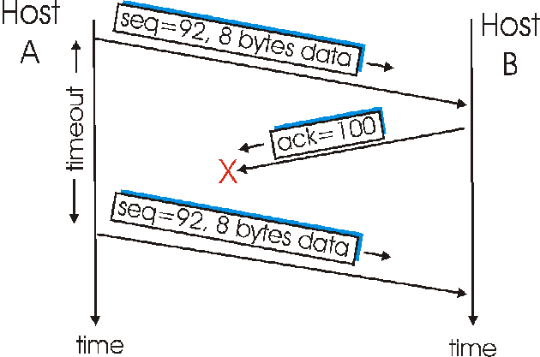
Retransmission-1

Slide 35
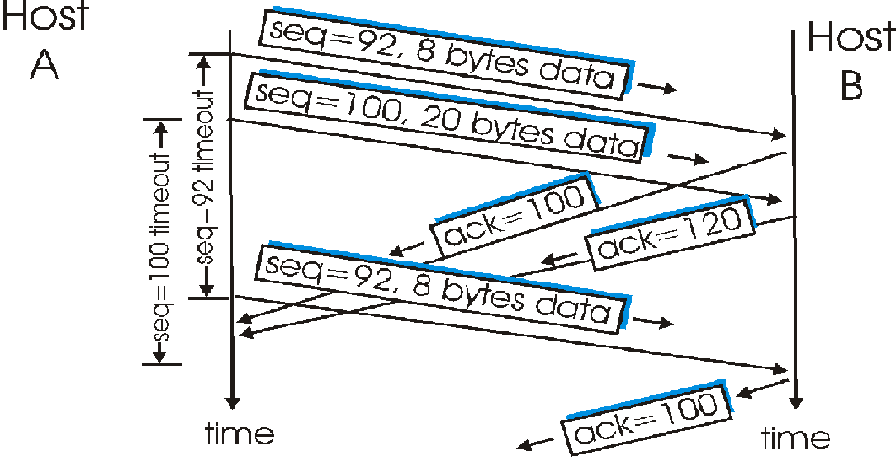
Retransmission-2
120

Slide 36
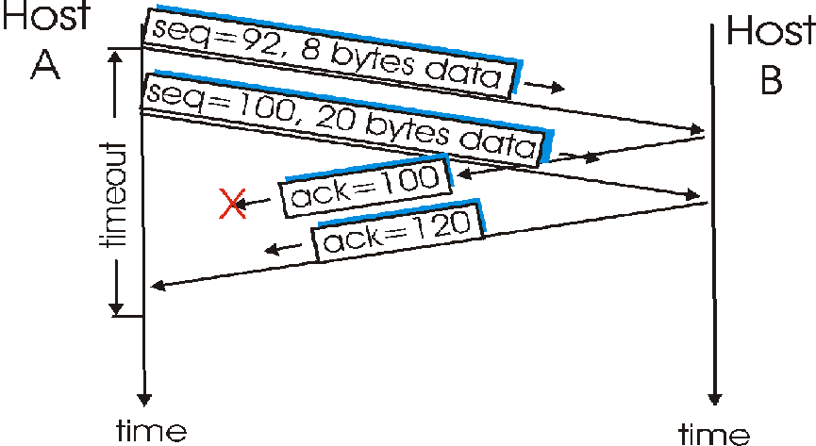
Retransmission-3

Slide 37
Principles of Congestion Control
Congestion:
informally: too many sources sending too much data too fast for network to handle
different from flow control!
manifestations:
  lost packets (buffer overflow at routers)
  long delays (queueing in router buffers)
a top-10 problem!

Slide 38
Approaches towards congestion control
End-end congestion control:
no explicit feedback from network
congestion inferred from end-system observed loss, delay
approach taken by TCP
Network-assisted congestion control:
routers provide feedback to end systems
  single bit indicating congestion (SNA, DECbit, TCP/IP ECN, ATM)
  explicit rate sender should send at

Slide 39
Congestion Control
Previously, TCP would start to transmit as much data as was allowed in the advertised window.
What about congestion ? What is it ?
A new window was added called the congestion window. –It is not negotiated, it is assumed. It starts out with one segment !

Slide 40
TCP Congestion Control
How does sender perceive congestion?
loss event = timeout or 3 duplicate acks
TCP sender reduces rate (CongWin) after loss event
three mechanisms:
  AIMD (additive increase, multiplicative decrease)
  slow start
  conservative after timeout events
end-end control (no network assistance)
sender limits transmission:
LastByteSent-LastByteAcked ≤ CongWin
Roughly,
CongWin is dynamic, function of perceived network congestion
CongWin
rate =
Bytes/sec
RTT

Slide 41
TCP Slow Start
When connection begins, increase rate exponentially fast until first loss event
When connection begins, CongWin = 1 MSS
  Example: MSS = 500 bytes & RTT = 200 msec
  initial rate = 20 kbps
available bandwidth may be >> MSS/RTT
  desirable to quickly ramp up to respectable rate

Slide 42
TCP Slow Start -2
When connection begins, increase rate exponentially until first loss event:
  double CongWin every RTT
  done by incrementing CongWin for every ACK received
Summary: initial rate is slow but ramps up exponentially fast
Host A
Host B
one segment
RTT
two segments
four segments
time

Slide 43
Refinement
Philosophy:
3 dup ACKs indicates
network capable of
delivering some segments
timeout before 3 dup
ACKs is more alarming
After 3 dup ACKs:
  CongWin is cut in half
  window then grows linearly
But after timeout event:
  CongWin instead set to 1 MSS;
  window then grows exponentially
  to a threshold, then grows linearly

Slide 44
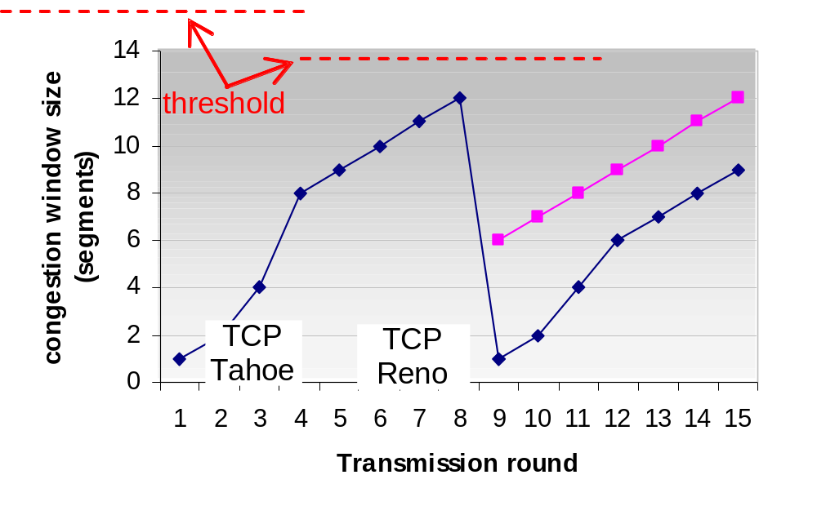
Refinement -2
Q: When should the exponential increase switch to linear?
A: When CongWin gets to 1/2 of its value before timeout.
Implementation:
Variable Threshold
At loss event, Threshold is set to 1/2 of CongWin just before loss event

Slide 45
Summary: TCP Congestion Control
When CongWin is below Threshold, sender in slow-start phase, window grows exponentially.
When CongWin is above Threshold, sender is in congestion-avoidance phase, window grows linearly.
When a triple duplicate ACK occurs,
  Threshold =CongWin/2
  CongWin = Threshold.
When timeout occurs,
  Threshold = CongWin/2
  CongWin =1 MSS.

Slide 46
TCP Fairness
Fairness goal: if K TCP sessions share same bottleneck link of bandwidth R, each should have average rate of R/K
TCP connection 1
TCP
connection 2
bottleneck
router
capacity R

Slide 47
Why is TCP fair ?
Two competing sessions:
Additive increase gives slope of 1, as throughout increases
multiplicative decrease decreases throughput proportionally
R
equal bandwidth share
loss: decrease window by factor of 2
Connection 2 throughput
congestion avoidance: additive increase
loss: decrease window by factor of 2
congestion avoidance: additive increase
Connection 1 throughput
R

Slide 48
Fairness !!!!
Fairness and UDP
Multimedia apps often do not use TCP
  do not want rate throttled by congestion control
Instead use UDP:
  pump audio/video at constant rate, tolerate packet loss
Research area: TCP friendly
Fairness and parallel TCP connections
nothing prevents app from opening parallel connections between 2 hosts.
Web browsers do this
Example: link of rate R with 9 connections;
  new app asks for 1 TCP, gets rate R/10
  new app asks for 11 TCPs, gets R/2 !

Slide 49
Congestion - Slow Start
Slow start initializes a congestion window of 1 segment. (Slow)
Each subsequent ACK increments this window exponentially (1, 2, 4, 8, etc.) eventually to the advertised window size
As long as there are no time-outs or duplicate ACKs during the transmission between two stations, it stays at the advertised window size.
The distinction here is that the congestion window is flow control imposed by the sender, while the Advertised window is flow control imposed by the receiver.

Slide 50
Congestion
Upon congestion (duplicate ACKs or time-out), the algorithm kicks back in.
  A comparison is made between the congestion window size and the advertised window size
  Whichever is smaller, is halved (1/2) and saved as the slow-start threshold
  The value must be at least 2 segments unless the congestion was a time-out, and then the congestion window is set to 1 (slow start) –
  The TCP sender can start up in slow start or congestion avoidance
If the congestion value matches (or is greater than) the value of slow-start threshold, the congestion avoidance algorithm starts; otherwise, slow start is brought up.
Upon receipt of ACKs, the congestion window is increased.
Allows for a more linear growth in transmission rate.

Slide 51
Reaction to timeouts
TIMEOUT:
  Threshold=CongW/2
  CongW = 1 ; slow start (exponential growth)
  When CongW >= Threshold → linear growth
Triplicate ACKs:
  CongW=CongW/2
  Linear grow

